Slide 1
Garbage Collection and Disposal
By Lalith Shashwath Krishna Shastry
and Andrew McGann
A Cpt_S 321 Student-Led Presentation

Slide 2
Basic Definitions
Garbage Collector: Manages the allocation and release of memory
Garbage Collection: The process of carrying out the Garbage Collector’s functionality to free and reallocate memory. This is done automatically in C#
Disposal: The process of explicitly discarding data to free memory

Slide 3
Refresher on Stack and Heap
Stack
The stack is a region of memory used for storing local variables and method call information. It operates in a last-in-first-out (LIFO) manner, making it efficient for managing these kinds of information.
Heap
The heap is a region of memory used for dynamic memory allocation. It’s where new objects, arrays, lists, etc. are allocated. Unlike the Stack, the Heap allows for non-contiguous memory allocation and is managed by the .NET garbage collector.

Slide 4
An understanding of Memory
The .NET framework provides automatic memory management in C#
Other examples: F#, J#, COBOL, Perl
Recall different memory types in C#:
Value types get allocated on the Stack
Reference types get allocated on the Heap

Slide 5
An understanding of Memory
Stack
All references
Heap
All object that are created in memory
Ref 1
Obj 1
Obj 2
Ref 2
Obj 3
Ref 3
Obj 4
Ref 4
Obj 5
Ref 5

Slide 6
What is Garbage Collection?
By definition, it is the process or mechanism within managed programming languages such as C# that automatically reclaims memory occupied by objects that are no longer used or reachable by the program.

Slide 7
Garbage Collection
In the common language runtime (CLR), the garbage collector (GC) serves as an automatic memory manager. It ensures efficient memory management and helps prevent memory leaks.
In simple terms, if something taking up memory is no longer needed or used, the garbage collection system automatically frees up that space by disposing the unused item.
In primitive programming languages such as C/C++, memory must be manually managed by the programmer (malloc(), free(), new, delete).

Slide 8
Benefits
Frees developers from having to manually release memory.
Allocates objects on the managed heap efficiently.
Reclaims objects that are no longer being used, clears their memory, and keeps the memory available for future allocations.
Managed objects automatically get clean content to start with, so their constructors don’t have to initialize every data field.
Provides memory safety by making sure that an object can’t use for itself the memory allocated for another object.

Slide 9
Conditions for a garbage collection
Garbage collection occurs when one of the following conditions is true:
The system has low physical memory. The memory size can be detected by either the operating system or the host.
The memory that’s used by allocated objects on the managed heap surpasses an acceptable threshold. This threshold is continuously adjusted as the process runs.
The GC.Collect method is called. In almost all cases, calling this method is unnecessary because the GC runs continuously.

Slide 10
Algorithm
The GC algorithm is based on several considerations:
It’s faster to compact the memory for a portion of the managed heap than for the entire managed heap.
Newer objects have shorter lifetimes, and older objects have longer lifetimes.
Newer objects tend to be related to each other and accessed by the application around the same time.
With these guidelines, the GC decides how/where to manage memory.

Slide 11
Generations
To help the GC, the managed heap is divided into three generations:
Generation 0 - The youngest, and contains short-lived objects.
Temporary variables, GC occurs most frequently here
Generation 1 - Contains short-lived objects and serves as a buffer between short-lived and long-lived objects.
Generation 2 - Contains long-lived objects
An object that contains static data that’s live for the duration of the process
Collecting a generation means collecting objects in all younger generations too.
Full garbage collection
After a collection, the memory is compacted and surviving objects get promoted.

Slide 12
The Process
A garbage collection has the following phases:
A marking phase that finds and creates a list of all live objects
Stack roots - provided by the JIT compiler and stack walker
Garbage collection handles - point to managed objects
Static data - each application domain keeps track of its static objects
A relocating phase that updates the references to the objects that will be compacted (survivors).
A compacting phase that reclaims the space occupied by the dead objects and compacts the surviving objects.

Slide 13
Unmanaged Resources
When creating objects that include unmanaged resources, you must explicitly release those resources when finished using them.
Objects that wrap OS resources
Files
Windows
Network connections
Database connections
The GC doesn’t how to release and clean up unmanaged resources (UR)
Implement the dispose pattern. A consumer of your type calls Dispose when the object is no longer needed, immediately releases UR

Slide 14
Safe Handles and Finalizers
If a consumer forgets to call Dispose, provide a way for your UR to be released:
Use a safe handle to wrap your UR (recommended)
Derived from the System.Runtime.InteropServices.SafeHandle abstract
Implement IDisposable → call safe handle’s Dispose method
Called automatically by the GC if its Dispose method is not called
Define (override) a finalizer
Non-deterministic release of UR
Robust version included in SafeHandle, can be complex and error-prone to define
Either the safe handle’s Finalize method or your own becomes a safeguard to clean up resources

Slide 15
Dispose
The dispose pattern is used for objects that implement the IDisposable interface
Dispose()
Free unmanaged resources, perform general cleanup, indicate that the finalizer shouldn’t run
Freeing the memory associated with a managed object is always the domain of the GC
Dispose(bool)
Where the actual cleanup happens
Parameter indicates whether the method call is from Dispose (true) or a finalizer (false)
Consists of three blocks of code:
A block for conditional return if object is already disposed
A block that frees unmanaged resources. Executes regardless of the parameter
A conditional block that frees managed resources
Can free managed objects that implement IDisposable or consume large amounts of memory / consume scarce resources

Slide 16
Dispose (cont.)
Cascade dispose calls
If your class owns a field/property and its type implements IDisposable, the containing class itself should also implement IDisposable
Derived classes
A class derived from a class that implements IDisposable should provide:
An override Dispose(bool) method to cleanup the derived class.
Must also call the base.Dispose(bool) method
A class derived from SafeHandle to wrap UR, or an override to Object.Finalize

Slide 17
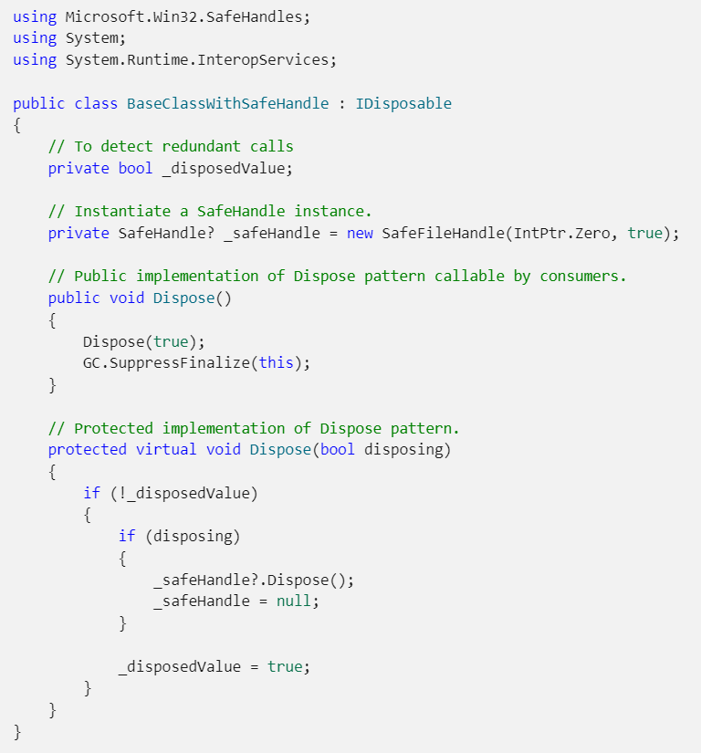
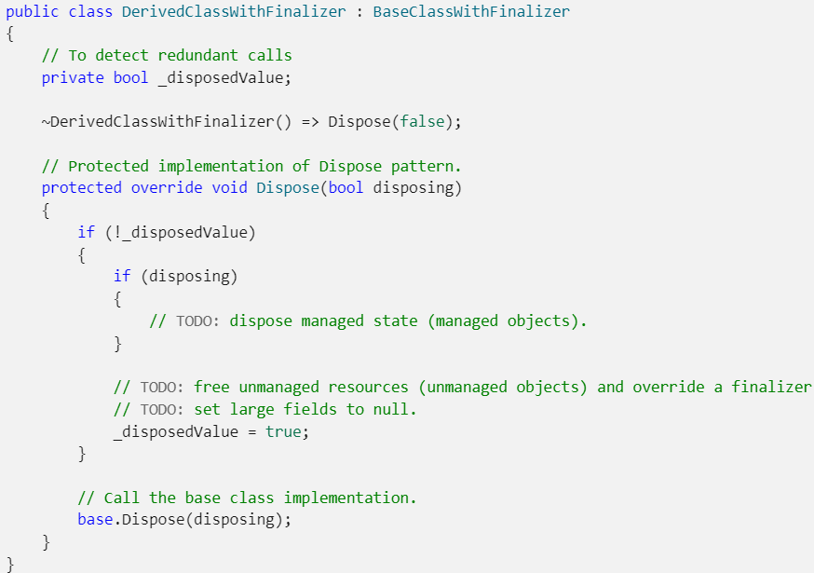
Implementing Dispose Pattern

Slide 18
Using objects that implement IDisposable
When you finish using an object that implements IDisposable, you call Dispose (or DisposeAsync) to explicitly perform cleanup:
With the C# ‘using’ statement or declaration
By implementing a try/finally block, and calling Dispose in the finally
Objects that implement IDisposable should always be properly disposed of
Calling SuppressFinalize indicates to the GC that the finalizer has already been run and the object shouldn’t be promoted for finalization

Slide 19
The ‘using’ statement and try/finally block
The using statement simplifies the code you must write to cleanup an object
Obtains one or more resources, executes the statements specified, and automatically disposes of the object
Only useful for objects that are used within the scope of the method in which they are constructed
You may choose to implement the try/finally block directly to…
Include a catch block to handle exceptions thrown in the try block
Instantiate an object that implements IDisposable whose scope is not local to the block within which it is declared

Slide 20
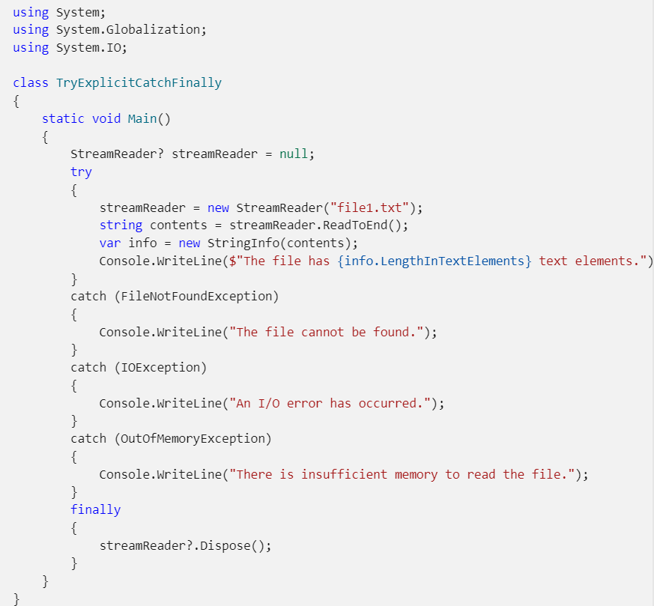
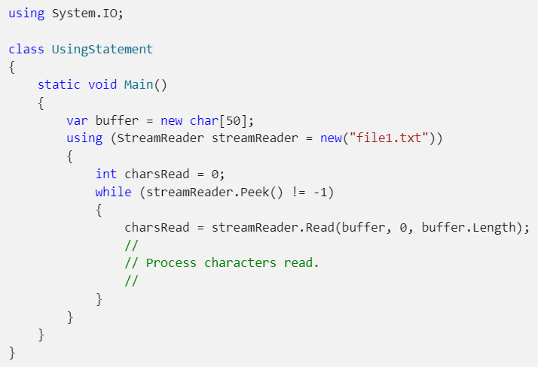
Implementing ‘using’ and try/finally

Slide 21
Code Demo

Slide 22
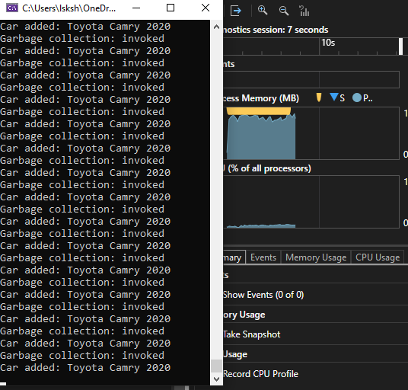
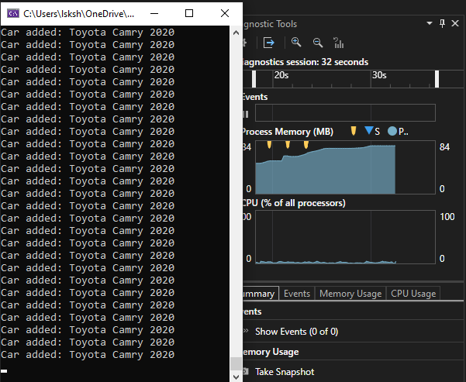
Code Demo Snippets

Slide 23
Your task

Slide 24
Why do we need this functionality?

Slide 25
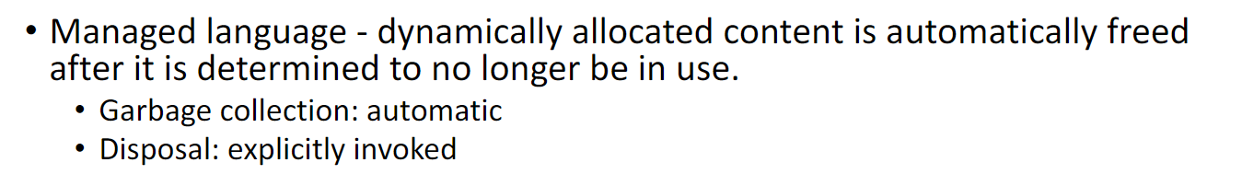
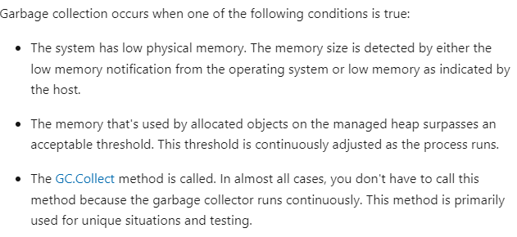

Slide 26
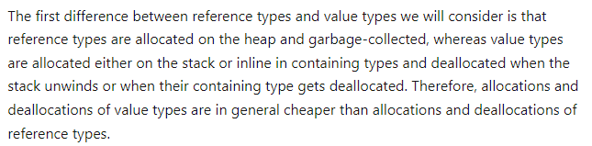
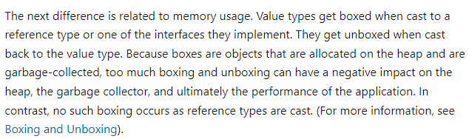

Slide 27
References
https://learn.microsoft.com/en-us/dotnet/standard/garbage-collection/fundamentals
https://learn.microsoft.com/en-us/dotnet/standard/garbage-collection/unmanaged
https://learn.microsoft.com/en-us/dotnet/standard/garbage-collection/implementing-dispose
https://learn.microsoft.com/en-us/dotnet/standard/garbage-collection/using-objects
https://www.slideshare.net/Kamal1997/gc-in-c

